Slide 1

AI in Pedestrian Dynamics
Complex Social Systems: Modeling Agents, Learning and Games
M. Eichenberger, I. Heidtmann, A. Jürgens, L. Milanovic, D. Zehnder
30. November 2020

Slide 2
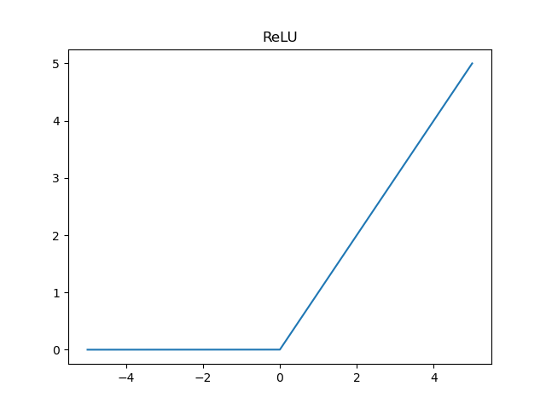
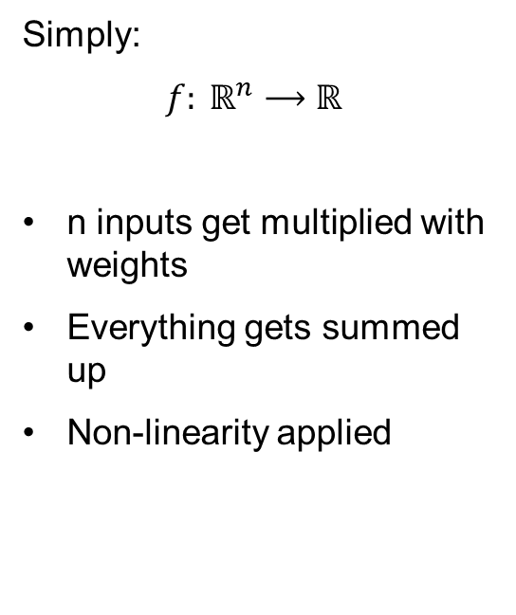
What are Neurons?
Simply:
${f: ℝ}^{n}⟶$ $ℝ$
n inputs get multiplied with weights
Everything gets summed up
Non-linearity applied
w₁
∑
ReLU()
w₂
w₃

Slide 3
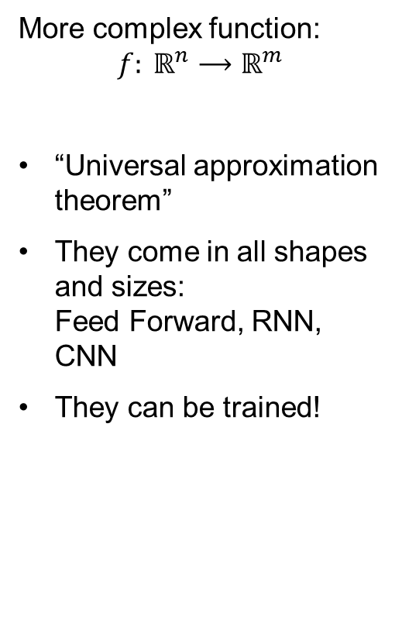
How to make networks out of them?
More complex function:
$${f: ℝ}^{n}⟶ℝ^{m}$$
“Universal approximation theorem”
They come in all shapes and sizes: Feed Forward, RNN, CNN
They can be trained!
∑
∑
∑
∑
∑
∑
Input Layer
Hidden Layer(s)
Output Layer

Slide 4
Training a computer?
Training modifies the weights
Minimizing the difference between output and “solution”
The difference is called Loss
Benefit: Network decides what is important and what is not
∑
∑
∑
∑
∑
∑

Slide 5
Methode
Complex Social Systems - A(I)-Team
Walking Agent
Testing
Hyperparameter
Training
Model layout
Overview
Pre-processing
Data

Slide 6
Methode
Complex Social Systems - A(I)-Team
Walking Agent
Testing
Hyperparameter
Training
Model layout
Data & Pre-processing
Pre-processing
Data

Slide 7
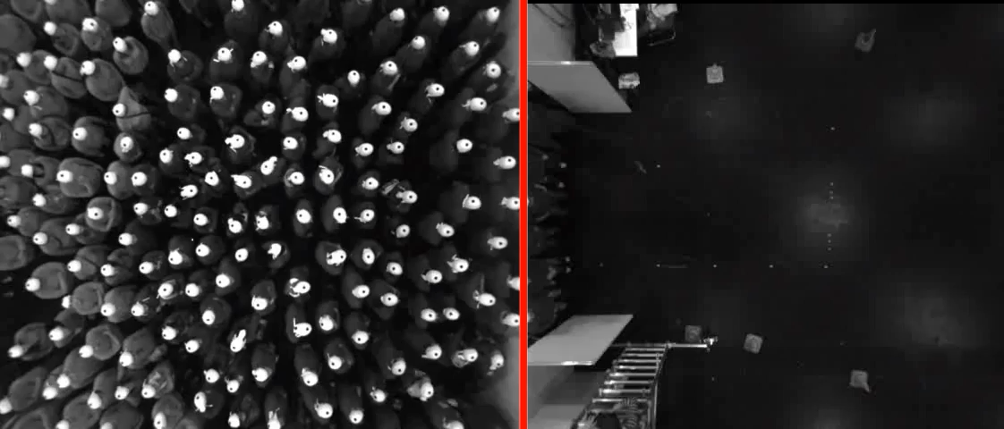
Methode - Data
Civil Saftety Research, Forschungszentum Jülich, https://ped.fz-juelich.de/database/doku.php
Trajectories generated from tracked video
Experimental Situation
Instruction : leave in ordered fashion
Advantages:
Pre tracked
Experimental setup well documented
Different situations

Slide 8
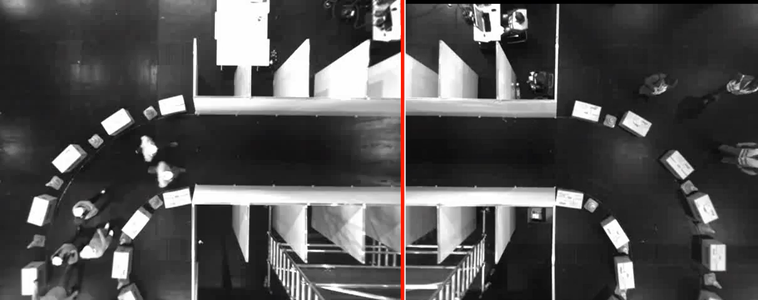
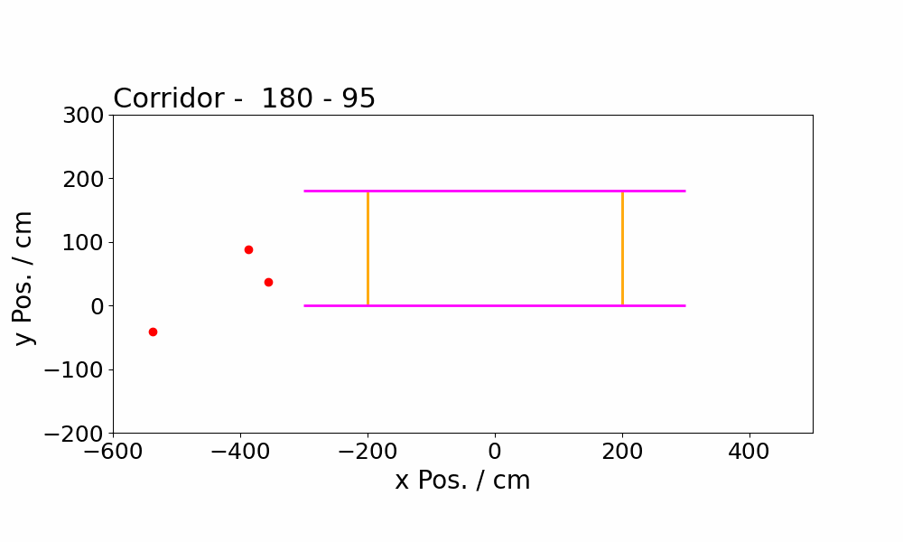
Methode - Data
Video: 16 FPS
Trajectories:
Encode geometry

Slide 9
Methode - Data
Corridor
Bottleneck
Width: 180 cm
Length: 600cm
People: 15-230
~2000 – 40’000 steps for Training
Width: 360 cm
People: 400
~20’000 steps for Training

Slide 10
Methode - Data
Truth extracting
Nearest Neighbours

Slide 11
Methode - Data
Truth extracting
Nearest Neighbours
Next Frame

Slide 12
Methode - Data
Truth extracting
Nearest Neighbours
Next Frame
Down sampling -> 2FPS
Wrapping

Slide 13
Methode
Complex Social Systems - A(I)-Team
Walking Agent
Testing
Hyperparameter
Training
Model layout
Model – Feed Forward
Pre-processing
Data

Slide 14
Methode - Model
k Nearest neighbours
Input:
Number of neighbours
Use velocities
Use past steps
Output:
Position
Velocities
Step n
P_{0,n}
V_{0,n}
P_{1,n}
V_{1,n}
P_{k,n}
V_{k,n}
Hidden Layers
Step n+1
P_{0,n+1}
V_{0,n+1}

Slide 15
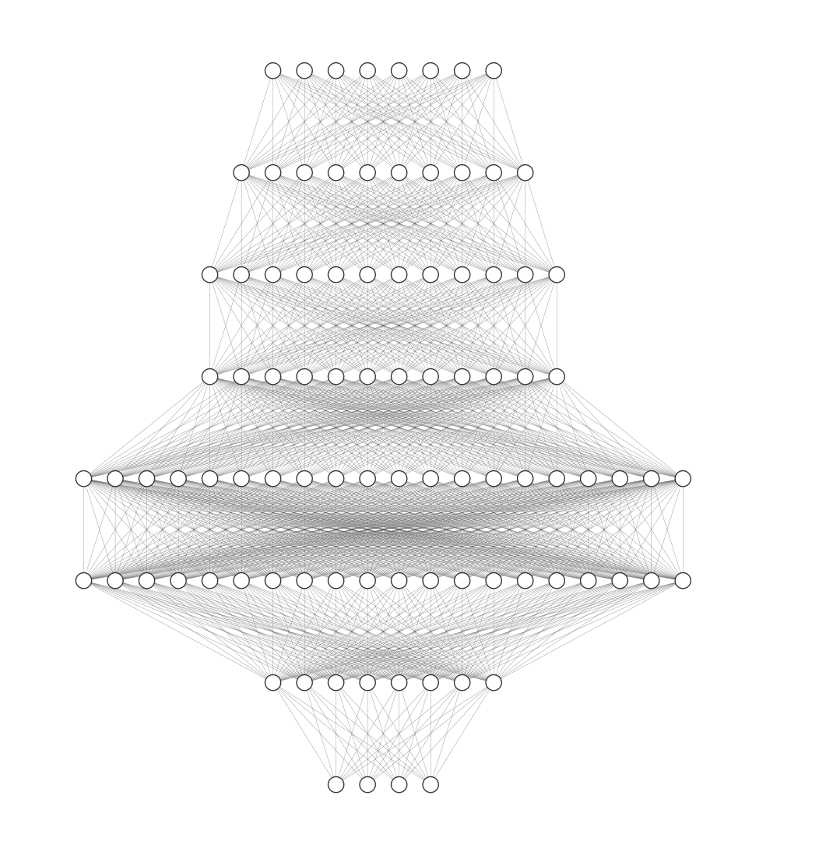
Methode - Model
30-120 max. Nodes
Hidden Layers:
5-6 Layers (shallow)
Approx. 30-120 Nodes per layer
Literature: Vehicle prediction network^{[1]}
Current Network :
Input: 6 Neighbours with velocities (28)
Hidden layers : (32, 32 ,64, 128, 128, 40 )
Output: Position & Velocities (4)
Bottleneck: Hidden Layer: (50, 20, 50)
[1] Feed-forwards meet recurrent networks in vehicle trajec-tory prediction, M. Bahari, A. Alahi, EPFL
[2] Visualize Architecture of Neural Network, http://alexlenail.me/NN-SVG/index.html
5-6 Layers

Slide 16
Methode
Complex Social Systems - A(I)-Team
Walking Agent
Testing
Hyperparameter
Training
Model layout
Training
Pre-processing
Data

Slide 17
Training the Neural Network
Optimizer
Loss
Prediction
y_pred = model(x)
loss = loss_fn(y_pred, y)
Refinements:
Batching
Adaptive Learning Rate
optimizer.step()

Slide 18
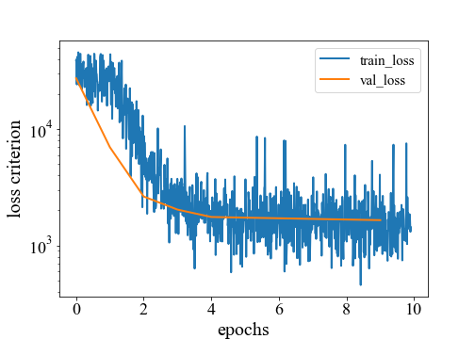
Training the Neural Network

Slide 19
Working process
Preparation - Data sets - Papers - Pytorch
1
Implementation - Auxiliary libraries - Various neural networks
2
Wrapping Up - Comparing results in pedestrian dynamics context
3

Slide 20
Methode
Complex Social Systems - A(I)-Team
Walking Agent
Testing
Hyperparameter
Training
Model layout
Walking Agent(s)
Pre-processing
Data

Slide 21
Results: Overview
How good does our trained model capture the behavior of a pedestrian?
Reproducing Data
General pedestrian characteristics
Trained Model
Stability of the model
Varying initial conditions
Adaptation to different scenarios
Varying person density
New scenarios
Statically placed people / Do agents sidestep?
Single Agent Sim.
Multi Agent Sim.

Slide 22
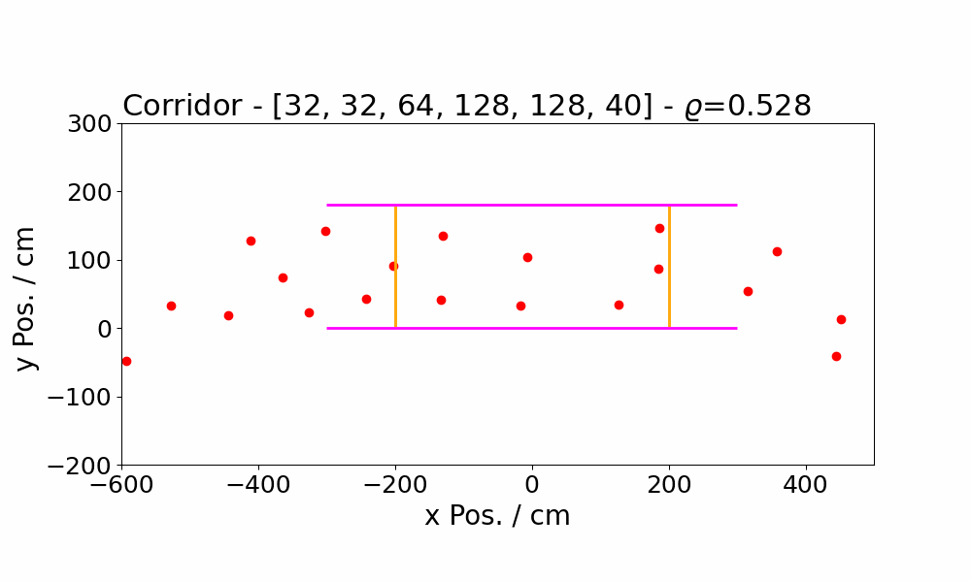
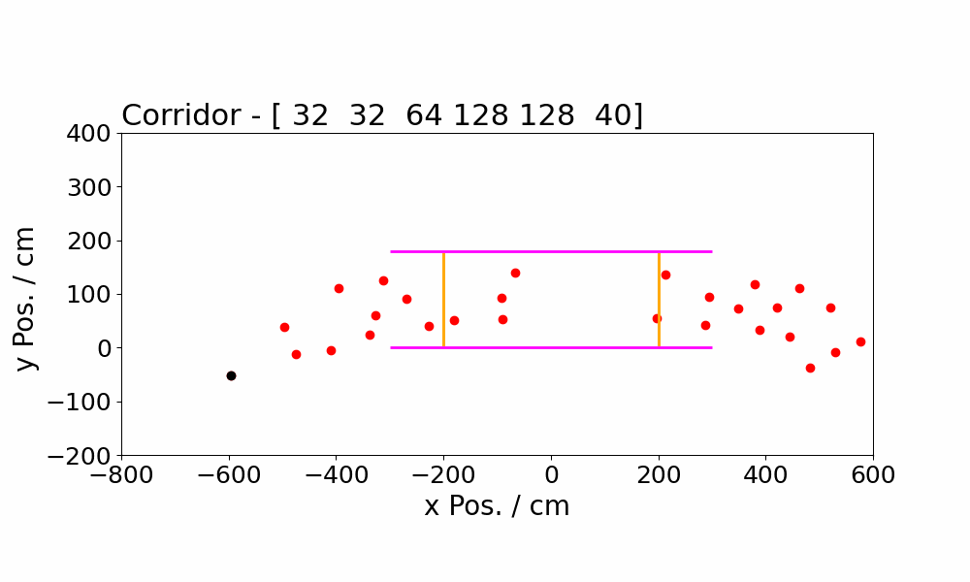
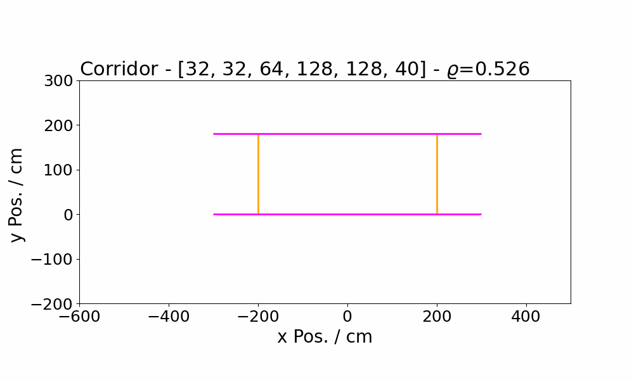
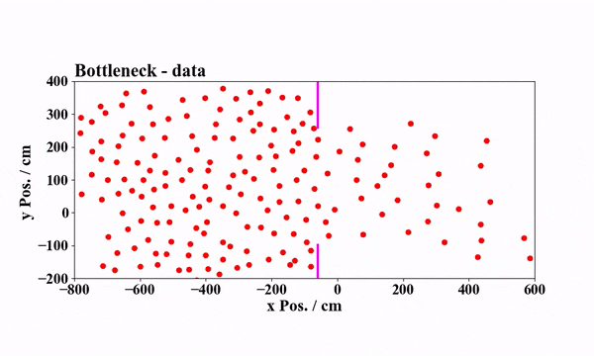
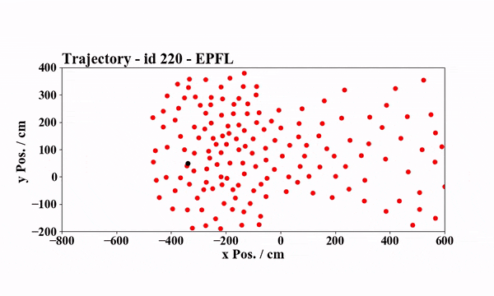
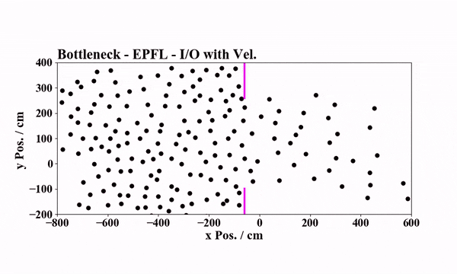
Results: Reproducing Data
Raw data
Single Agent
All Agents
Corridor
Bottleneck

Slide 23
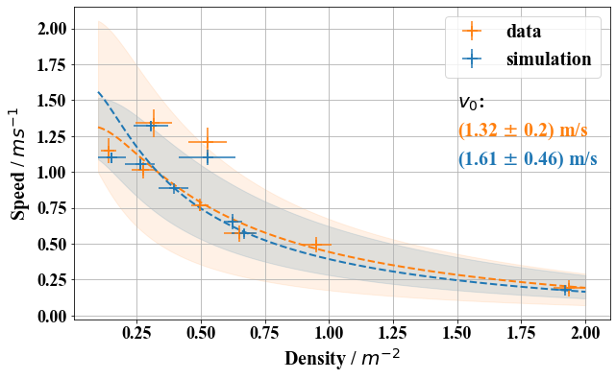
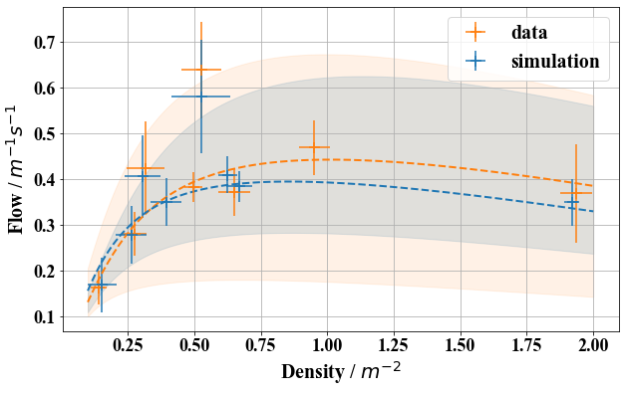
Results: Corridor
Apply one Model to different scenarios vary people density
Measure mean density and speed in ROI
Average over frames
Problematic: Inhomogeneous raw data (fluctuations in speed)
Region of Interest (ROI)

Slide 24
Results: Corridor
Apply one Model to different scenarios vary people density
Measure mean density and speed in ROI
Average over frames
Problematic: Inhomogeneous raw data (fluctuations in speed)
Region of Interest (ROI)

Slide 25
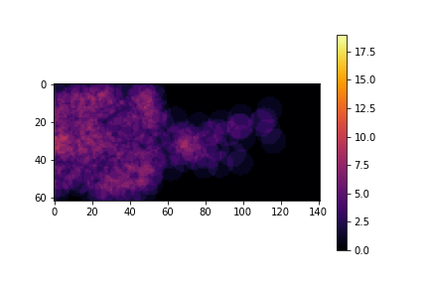
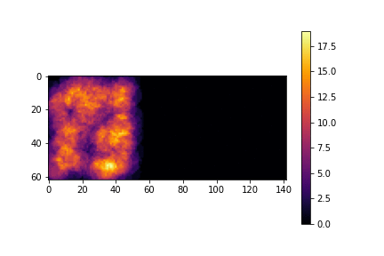
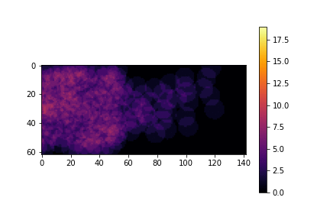
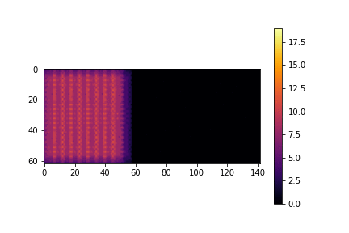
Results - Bottleneck
Training Data
Simulation with random initial positions
Simulation with initial positions from trainig data
Simulation with homogenously distributed initial positions

Slide 26
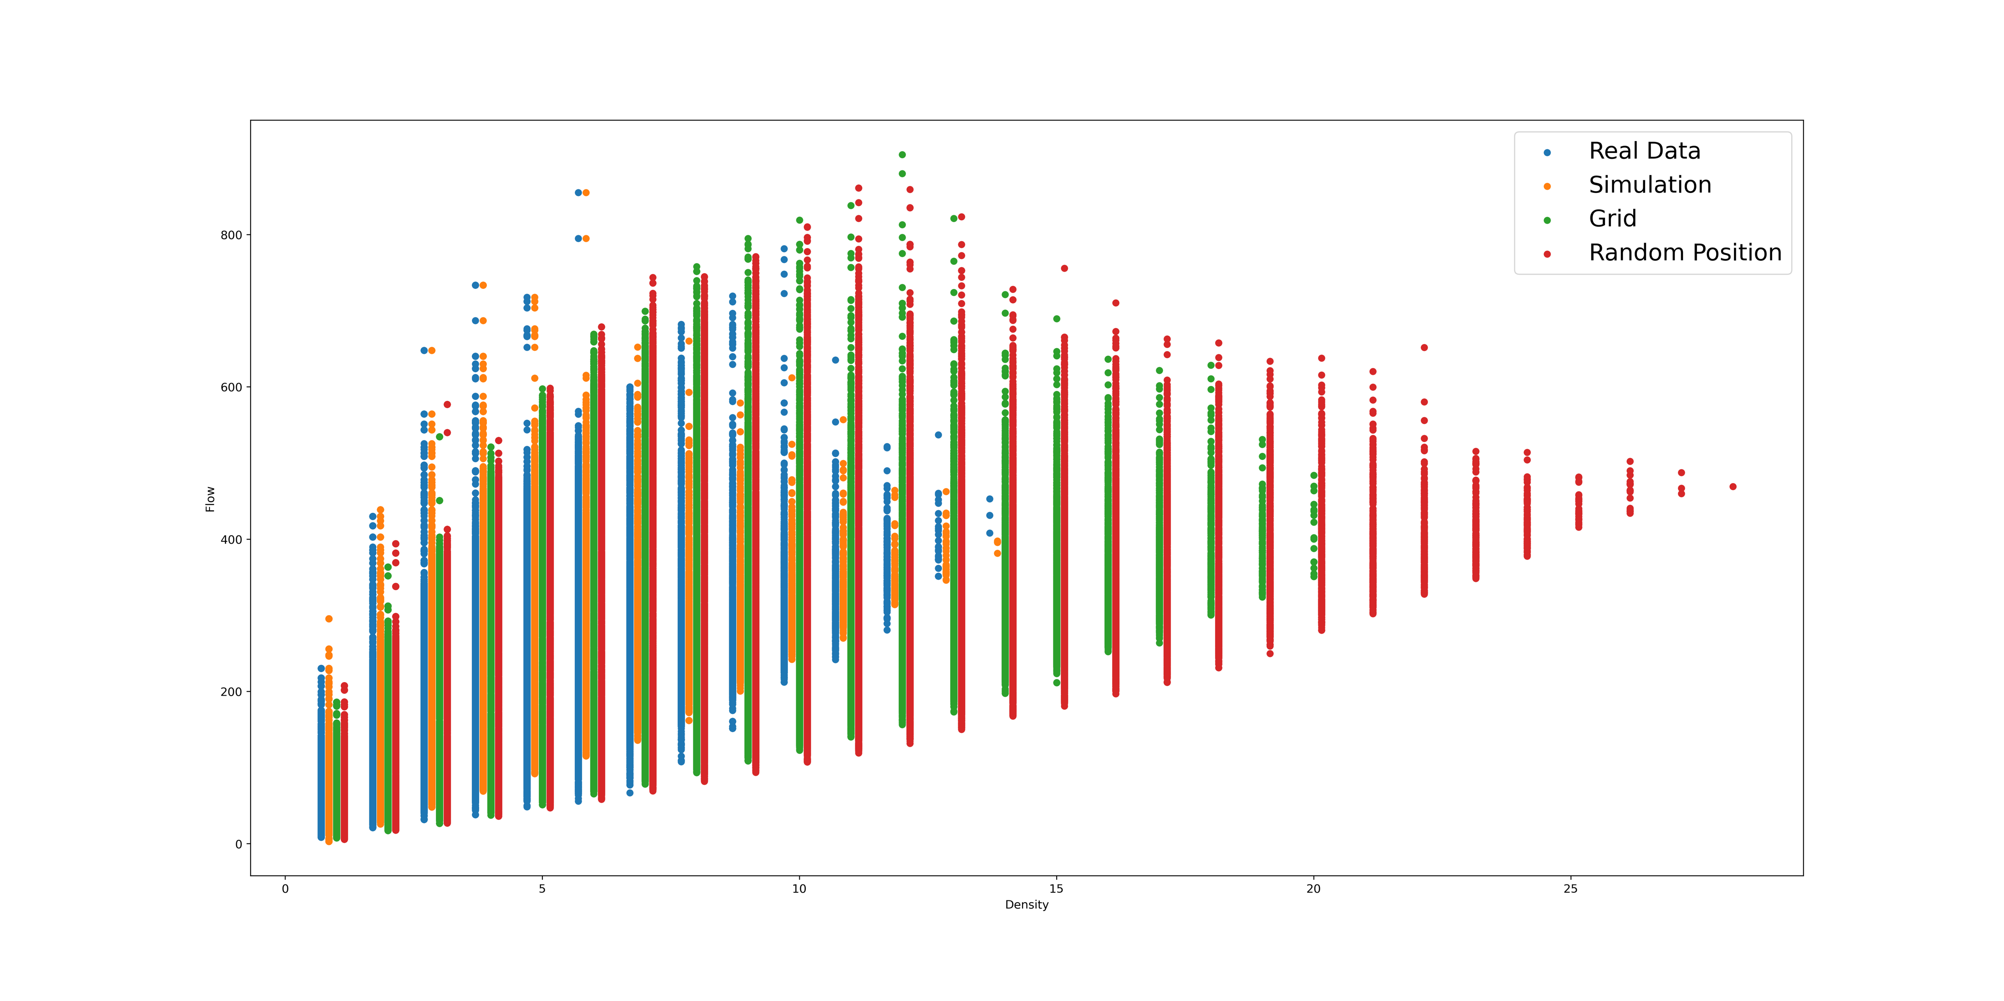
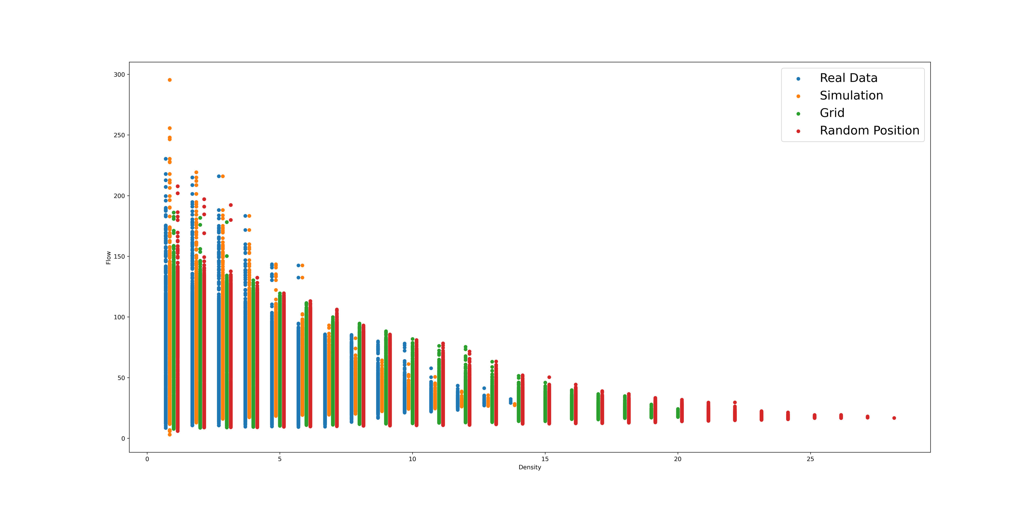
Results - Bottleneck
Speed
Density

Slide 27
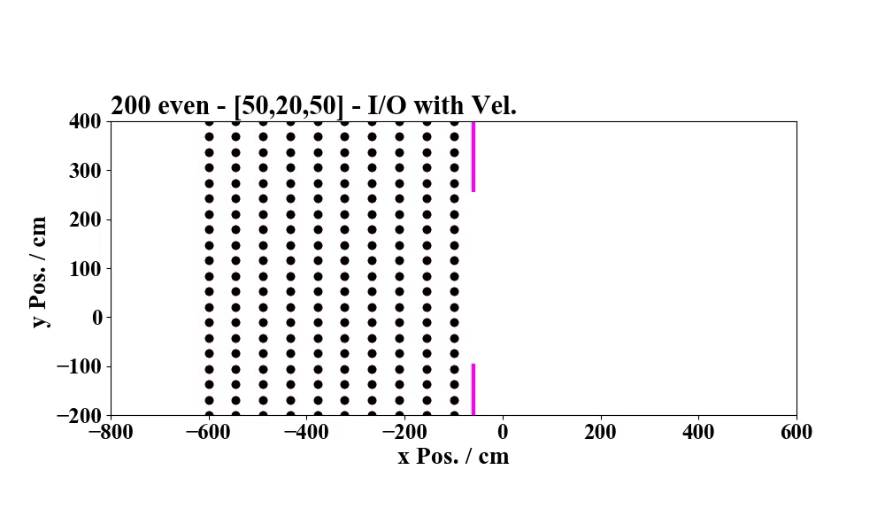

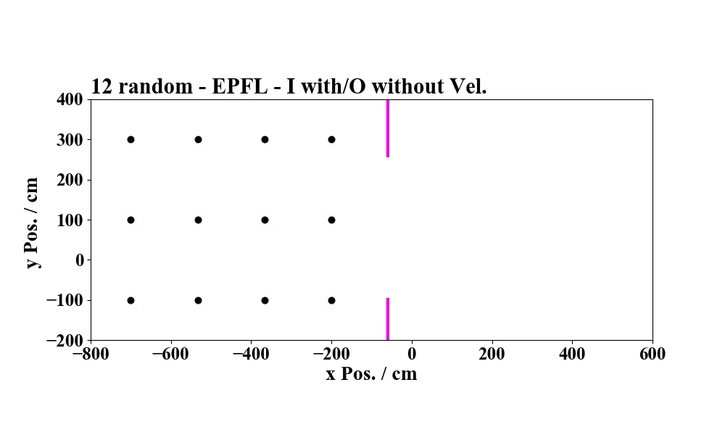
Limitations of our approach
Geometry of problem learnt on a data-driven basis
Difficult to adapt to new environment
Agents not forced to respect the geometry of the Problem
Agents adhere less to the geometry at low densities
Does not simulate fundamental changes in human behaviour such as panicking

Slide 28
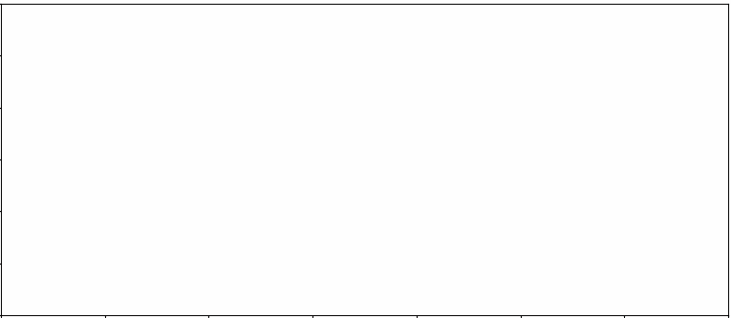
Outlook
Possible Future Approaches
Modify the architecture to ensure geometry compatibility
Hard-code geometry into network architecture
LSTMs?
Generative Adversarial Networks?
Apply same method to similar problems
Bidirectional Flow, Intersections, …
Different Agents such as cars, animals, …
3D setups such as stairs, hills, roads,…

